Slide 1


SPRING XD
EXTREME DATA ON SPRING

Slide 2


Michael Minella
Twitter: @michaelminella
Spring XD
Home: http://projects.spring.io/spring-xd/
Github: http://github.com/spring-projects/spring-xd
Jira: https://jira.spring.io/browse/XD

Slide 3


Slide 4

11
14
7
12
20
16
5
17
3
6
2
8
18
13
3
1
10
19
23
15
9

Slide 5

BIG
REAL-TIME
GEMFIRE
AMBARI
GROWING
YARN
HAWQ
SQOOP
HBASE
STORM
INTERNET OF THINGS
PETABYTE
MAP REDUCE
DATA
PIVOTAL HD
MAHOUT
FLUME
RECOMMENDATIONS
HIVE
SPARK
OOZIE
HADOOP
SPRING
PIG

Slide 6

SPRING XD
EXTREME DATA

Slide 7
/**
* @author Michael Minella
*/
@Configuration
@ComponentScan
@EnableAutoConfiguration
public class Application {
@Bean
ItemBasedRecommender recommender(DataSource dataSource) {
DataModel dataModel = new MySQLBooleanPrefJDBCDataModel(dataSource);
ItemSimilarity similarity = new MySQLJDBCItemSimilarity(dataSource);
AllSimilarItemsCandidateItemsStrategy candidateItemsStrategy =
new AllSimilarItemsCandidateItemsStrategy(similarity);
return new GenericItemBasedRecommender(dataModel, similarity, candidateItemsStrategy, candidateItemsStrategy);
}
public static void main(String[] args) {
SpringApplication.run(Application.class, args);
}
}

Slide 8
BIG
REAL-TIME
GEMFIRE
AMBARI
GROWING
YARN
HAWQ
SQOOP
HBASE
STORM
INTERNET OF THINGS
PETABYTE
MAP REDUCE
DATA
PIVOTAL HD
MAHOUT
FLUME
RECOMMENDATIONS
HIVE
SPARK
OOZIE
HADOOP
SPRING
PIG

Slide 9




APPLICATION
COMPLEXITY

Slide 10


LOTS OF
BOILERPLATE

Slide 11

MANY DOMAINS TO
BRIDGE

Slide 12


INCONSISTENT
APIS
Notes:
And immature
Spark is a good example
Went 1.0 earlier this year

Slide 13
SOURCE, CHANEL, SINK
DATA FLOW MODEL
=
ADAPTER, CHANEL, FILTER, TRANSFORMER, ETC
EIP PATTERNS

Slide 14
JOBS,CONNECTORS
IMPORT/EXPORT
=
JOBS, READERS/WRITERS
BATCH PROCESSING

Slide 15
WORKFLOW, ACTION
WORKFLOW
ORCHESTRATION
=
JOB, STEP
BATCH PROCESSING

Slide 16
SPRING XD
EXTREME DATA

Slide 17

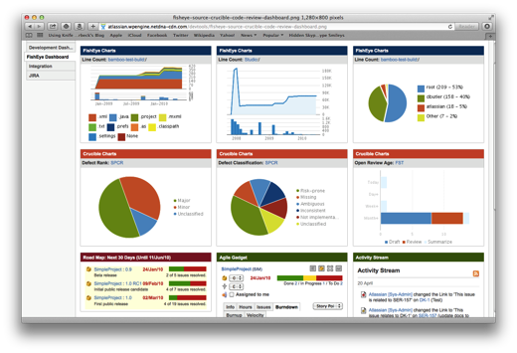




Ingestion
Orchestration
SPRING
Extraction
Real-time
Analytics
Notes:
Spring XD handles everything in the circle

Slide 18

DISTRIBUTED
RUNTIME

Slide 19


&
STREAMING
BATCH

Slide 20
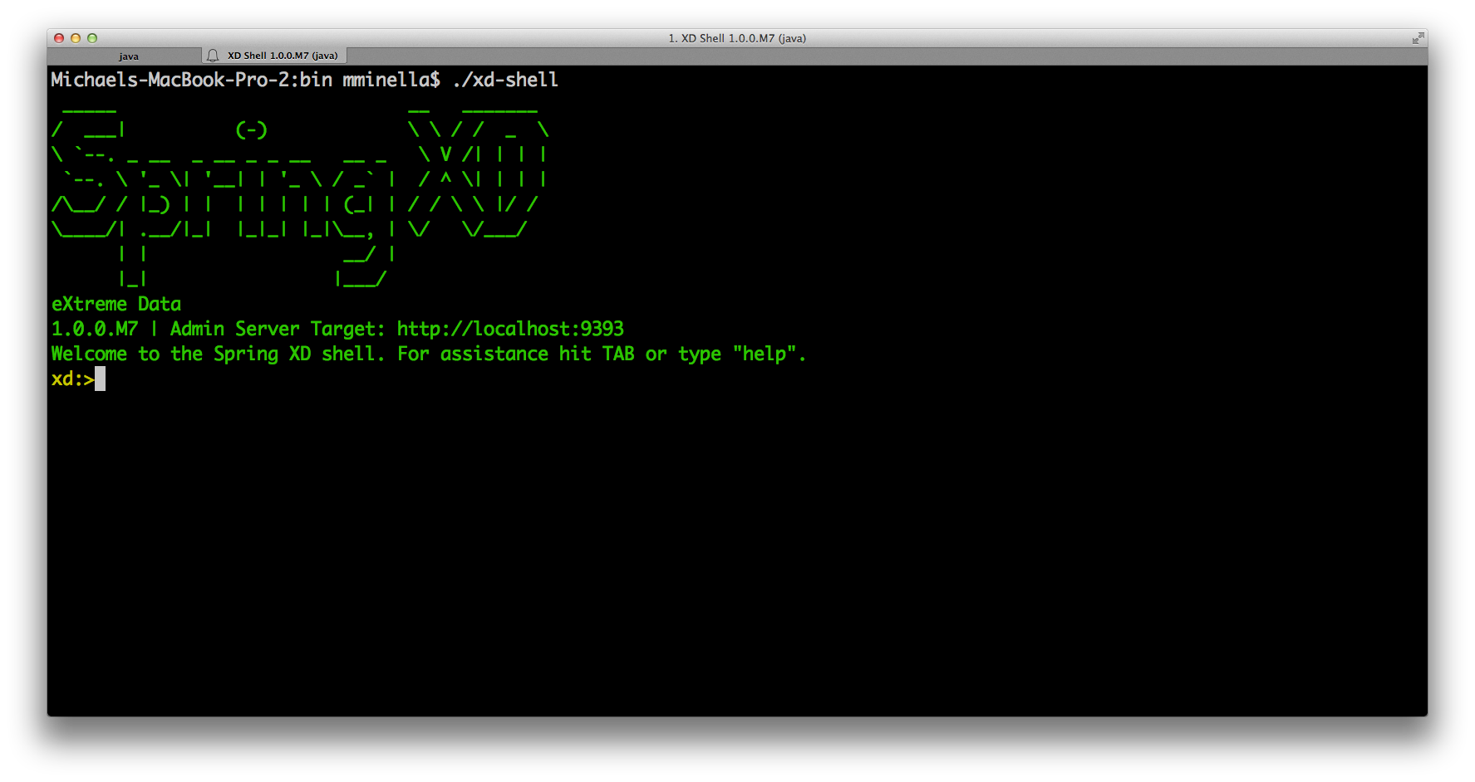

Slide 21

BUILT ON BATTLE TESTED
COMPONENTS

Slide 22
Admin
http | filter | file
CLUSTERED NODE
CLUSTERED NODE
CLUSTERED NODE
SINGLE NODE
HTTP Module
Filter Module
File Module
Modules
Rabbit, Redis
(Pluggable)
Local Channels

Slide 23
http
|
hdfs
--directory=/xd/dir1
--port=8181
filter --expression=“payload?.price > 3.00” |

Slide 24
twittersearch --query=#spring | file
tap:stream:tweets > field-value-counter \
--fieldName=entities.hashtags.text \
--counterName=tags

Slide 25

DEMO

Slide 26
/**
* @author Michael Minella
*/
@Configuration
@ComponentScan
@EnableAutoConfiguration
public class Application {
@Bean
ItemBasedRecommender recommender(DataSource dataSource) {
DataModel dataModel = new MySQLBooleanPrefJDBCDataModel(dataSource);
ItemSimilarity similarity = new MySQLJDBCItemSimilarity(dataSource);
AllSimilarItemsCandidateItemsStrategy candidateItemsStrategy =
new AllSimilarItemsCandidateItemsStrategy(similarity);
return new GenericItemBasedRecommender(dataModel, similarity, candidateItemsStrategy, candidateItemsStrategy);
}
public static void main(String[] args) {
SpringApplication.run(Application.class, args);
}
}

Slide 27

EXTENDING
SPRING XD

Slide 28
11
14
7
12
20
16
5
17
3
6
2
8
18
13
3
1
10
19
23
15
9

Slide 29
1
CUSTOM
MODULES

Slide 30
2
EXTEND THE
CONTAINER

Slide 31

CUSTOM
MODULES

Slide 32

SPRING
CONTEXT

Slide 33

HONOR THE
CONTRACTS
Notes:
Four module types:
Source
Processor
Sync
Job

Slide 34

SOURCE
OUTPUT CHANNEL

Slide 35
PROCESSOR
INPUT & OUTPUT CHANNEL

Slide 36
SYNC
OUTPUT CHANNEL

Slide 37
JOB
JOB

Slide 38
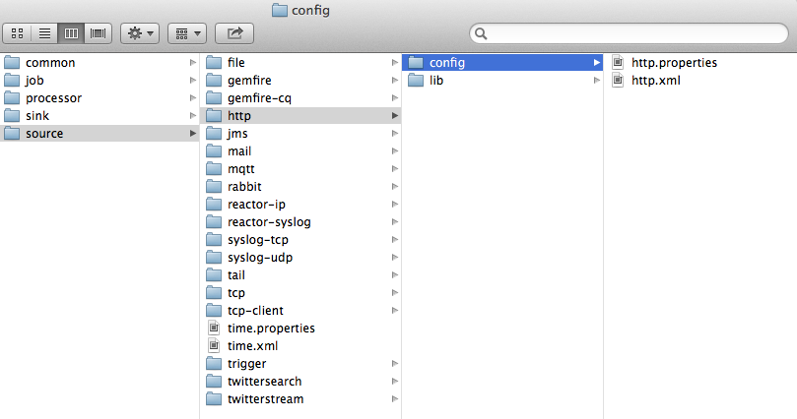

Slide 39
/**
* @author Michael Minella
*/
@Configuration
@ComponentScan
@EnableAutoConfiguration
public class Application {
@Bean
ItemBasedRecommender recommender(DataSource dataSource) {
DataModel dataModel = new MySQLBooleanPrefJDBCDataModel(dataSource);
ItemSimilarity similarity = new MySQLJDBCItemSimilarity(dataSource);
AllSimilarItemsCandidateItemsStrategy candidateItemsStrategy =
new AllSimilarItemsCandidateItemsStrategy(similarity);
return new GenericItemBasedRecommender(dataModel, similarity, candidateItemsStrategy, candidateItemsStrategy);
}
public static void main(String[] args) {
SpringApplication.run(Application.class, args);
}
}

Slide 40


Slide 41

The
End

Slide 42

Learn More. Stay Connected.
Spring Framework
Project: spring.io/spring-framework
Github: github.com/spring-projects/spring-framework
Jira: jira.spring.io/browse/SPR
Spring XD
Project: spring.io/spring-xd
Github: github.com/spring-projects/spring-xd
Jira: jira.spring.io/browse/XD
Twitter: twitter.com/springcentral
YouTube: spring.io/video
LinkedIn: spring.io/linkedin
Google Plus: spring.io/gplus

Slide 43






Handshake by Nicholas Menghini from
The Noun Project
Question by Jessica Lock from
The Noun Project
Servers by Jaime Carrion from
The Noun Project
Crane by Kenneth Von Alt from
The Noun Project
Pointing by Anthony Lui from
The Noun Project
Running by Dillon Arloff from
The Noun Project
Nut by Naomi Atkinson from
The Noun Project
Database by Anton Outkine from
The Noun Project
Puzzle by Eric M. Ellis from
The Noun Project
Puzzle by matthew hall from
The Noun Project
Network by Mister Pixel from
The Noun Project
Tank by Renan Ferreira Santos from
The Noun Project
cylinder by Michael Senkow from
The Noun Project

